Slide 1

HEC GENAI HACKATHON
Group 26
Cohort 02
INTELLIGENT REQUIREMENT ANALYSIS SYSTEM
ReqMind
AI
Transforming Unstructured Requirements into Structured Intelligence
Team Members
Asifa Siraj • Warisha Danin Bilal • Iman Ayaz
Zobia Hassan • Mahzaib Iqbal • Mansoor Ahmed
February 2026

Slide 2
PRESENTATION OVERVIEW
Agenda
01
Introduction
04
System Architecture
The Challenge of Requirement Engineering
Design for Scalability
02
Problem Statement
09
Conclusion
Understanding the Root Causes
The Future of RE
03
Proposed Solution
ReqMind AI Architecture

Slide 3
CHAPTER 01
Introduction
The Challenge of Requirement Engineering

Slide 4
INTRODUCTION
The Requirement Engineering Crisis
The Problem
Our Solution
Software project failure and delay remain critical issues in software engineering. A primary cause is poorly defined, ambiguous, or incomplete requirements that create cascading problems throughout the development lifecycle.
To address this challenge, we propose ReqMind AI , a Generative AI–powered system that transforms unstructured requirement text into structured, organized, and actionable output.
Stakeholder Challenge
Stakeholders frequently provide raw textual descriptions lacking structure , resulting in misinterpretation, scope creep, rework, budget overruns, and dissatisfaction.
1
Intelligent Processing
Manual Analysis Bottleneck
AI-powered analysis and extraction
Manual requirement analysis requires significant expertise and time , creating a bottleneck that slows down project initiation and increases costs.
2
Structured Output
JSON format for easy integration
3
Time Efficiency
Reduce analysis time by 80%

Slide 5
CHAPTER 02
Problem Statement
Understanding the Root Causes

Slide 6
PROBLEM STATEMENT
Industry Context: The Scale of Project Failure
50%
70-85%
of software defects
average cost overrun
originate from it
beyond initial budget
Key Insight
These statistics highlight the critical need for improved requirement engineering practices. Poorly defined requirements are a primary contributor to project failures, cost overruns, and delays. ReqMind AI addresses this fundamental challenge by bringing structure and intelligence to the requirement analysis process.

Slide 7
PROBLEM STATEMENT
Root Causes: Why Requirements Fail
1
Vague Requirements
Real-World Example
Impact: Developer confusion and scope creep. Requirements like "fast" or "user-friendly" lack measurable criteria, leading to subjective interpretations and misaligned expectations.
2
Manual Analysis
Ambiguous Requirement:
Impact: 4–8 hours per SRS document. Manual review is time-consuming, error-prone, and requires specialized expertise that many teams lack.
"App should be fast and user-friendly."
Not measurable - What defines "fast"?
3
Lack of Expertise
Subjective criteria - "User-friendly" varies by user
Impact: Small teams lack requirement engineers. Without dedicated RE professionals, critical aspects are overlooked, leading to incomplete specifications.
No performance metrics specified
Missing context - Target devices, user roles
4
Poor Communication
Impact: Product deviates from expectations. Miscommunication between stakeholders and developers results in deliverables that don't meet business needs.

Slide 8
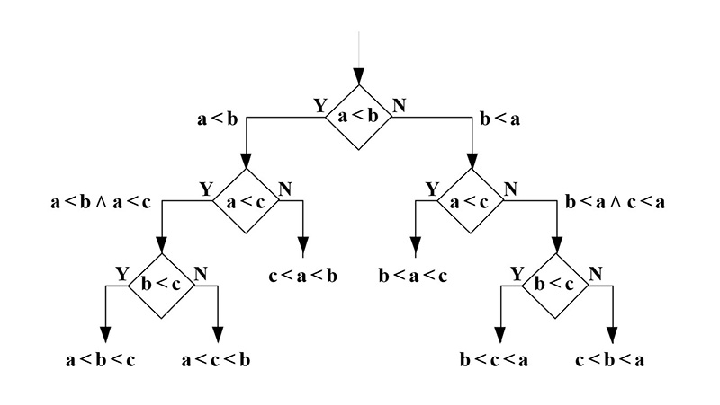
CHAPTER 03
Proposed Solution
ReqMind AI - Transforming Chaos into Clarity

Slide 9
PROPOSED SOLUTION
Core Capabilities: Seven Pillars of Intelligence
Functional Requirement Extraction
Non-Functional Requirement Extraction
Ambiguity Detection
Automatically identifies and categorizes functional requirements specifying what the system should do, including user actions, system behaviors, and feature specifications.
Extracts performance, security, usability, and reliability constraints with specific metrics and measurable criteria for quality assurance.
Identifies vague terms, subjective language, and unclear specifications that could lead to misinterpretation and scope creep during development.
Missing Information Identification
Clarification Question Generation
Structured JSON Output
Detects gaps in requirements such as undefined user roles, unspecified business rules, missing constraints, and incomplete scenarios.
Generates targeted questions to help stakeholders provide missing details and resolve ambiguities, facilitating clearer communication.
Produces machine-readable structured output that can be easily integrated with development tools, project management systems, and CI/CD pipelines.
PDF Report Export
Generates professional PDF reports with structured analysis, visual diagrams, and actionable recommendations for stakeholders and development teams. Reports include executive summaries, detailed requirement breakdowns, identified issues, and suggested improvements.

Slide 10
PROPOSED SOLUTION
Illustrative Example: Before & After
Structured Output
Raw Input
Functional Requirements
• User authentication and login system
• Dashboard display with data visualization
• Mobile-responsive interface
"Build a mobile app that works fast, secure, and easy to use."
Non-Functional Requirements
• Performance: Load time < 3 seconds
• Security: AES-256 encryption
• Usability: 95% task completion rate
Detected Issues
Vague performance criteria
• Ambiguity: "fast" needs definition
No security specifications
• Missing: Target devices, user roles
Subjective usability definition
• Question: What defines usability priority?

Slide 11
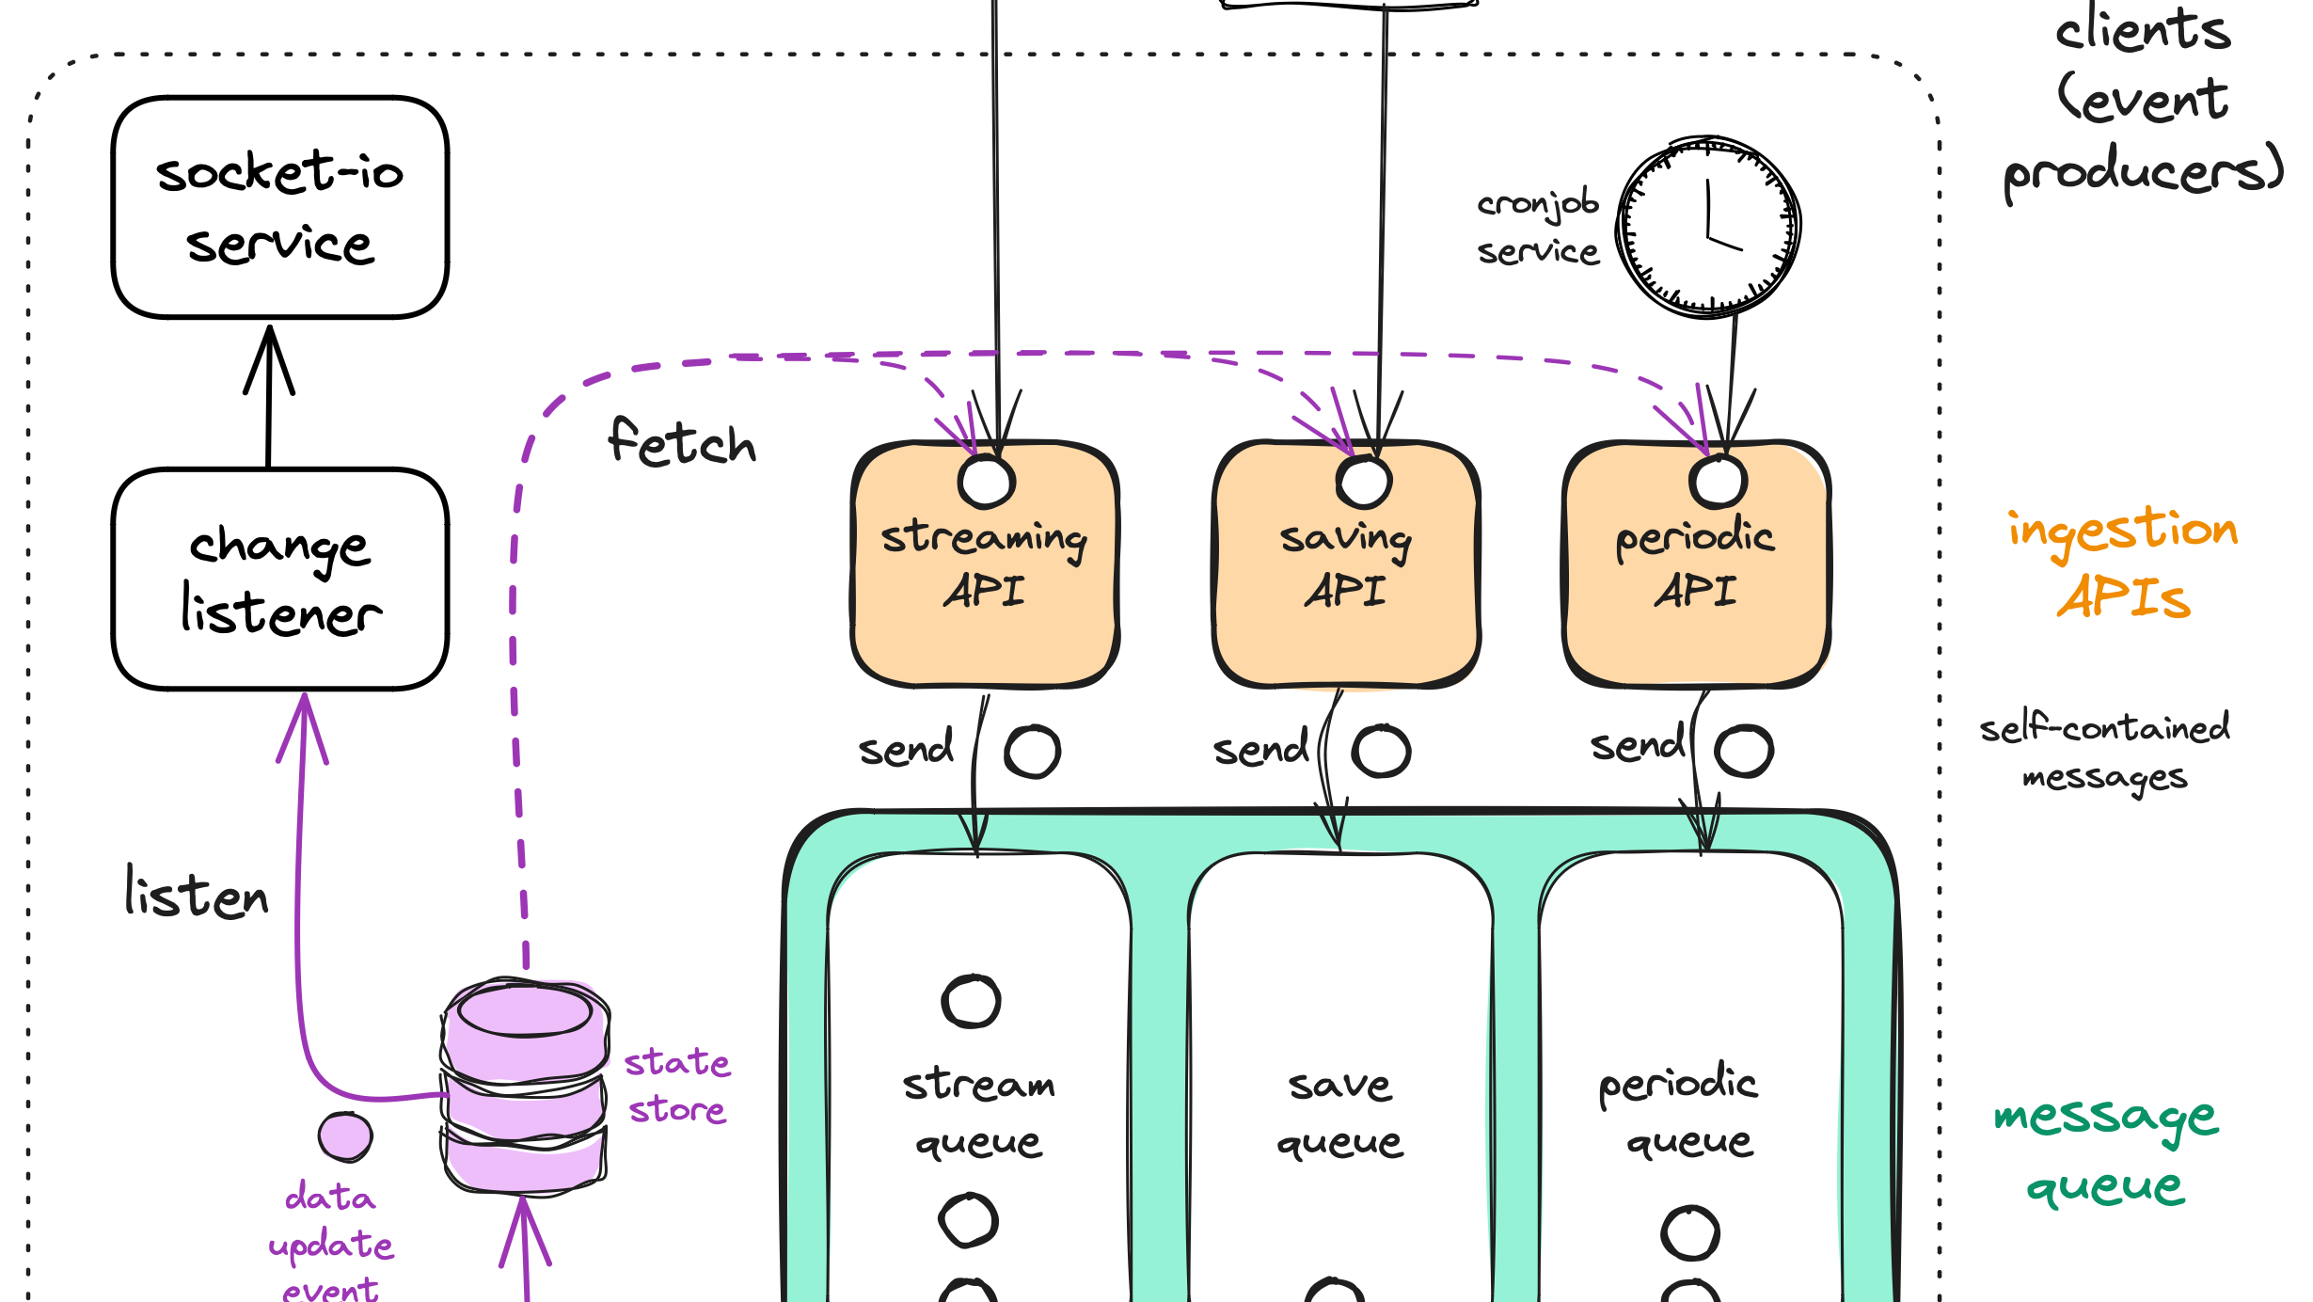
CHAPTER 04
System Architecture
Design for Scalability & Intelligence

Slide 12
SYSTEM ARCHITECTURE
Technology Stack: Modern & Efficient
Frontend: Gradio
AI Model: Hugging Face
Rapid UI development framework for Python, enabling quick prototyping and deployment of data applications.
State-of-the-art LLM hosting with meta-llama/Llama-3.2-3B for intelligent requirement analysis and extraction.
Web-based
Python-native
Real-time
LLaMA 3.2
3B params
Inference API
Backend: Python
PDF Generation
Robust processing logic with extensive libraries for data manipulation, API integration, and document generation.
Professional document generation using ReportLab and FPDF libraries for structured, styled PDF reports.
FastAPI
Async
Scalable
ReportLab
Custom styling
Architecture Rationale: This technology stack was chosen for its rapid development capabilities , robust processing power , and seamless AI integration . Python's extensive ecosystem enables efficient backend processing, while Streamlit provides an intuitive frontend without complex JavaScript development. Hugging Face offers state-of-the-art LLM access without infrastructure management.

Slide 13
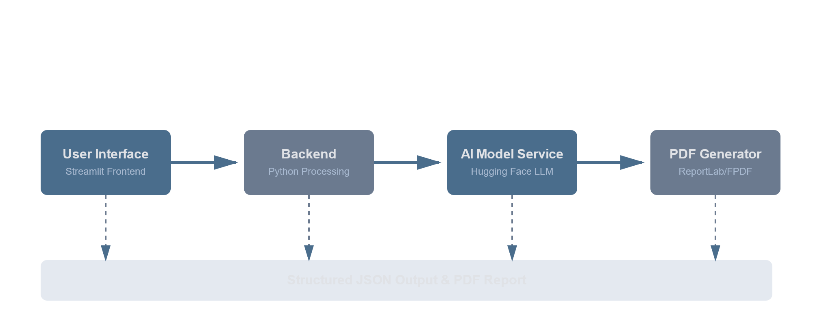

SYSTEM ARCHITECTURE
Overall System Architecture
User Interface
Backend Processing
AI Model Service
Report Generation
Gradio-based frontend for intuitive requirement input and results visualization
Python-based logic for prompt engineering and response processing
Hugging Face integration with LLaMA 3.2 for intelligent analysis
PDF export functionality for professional documentation

Slide 14
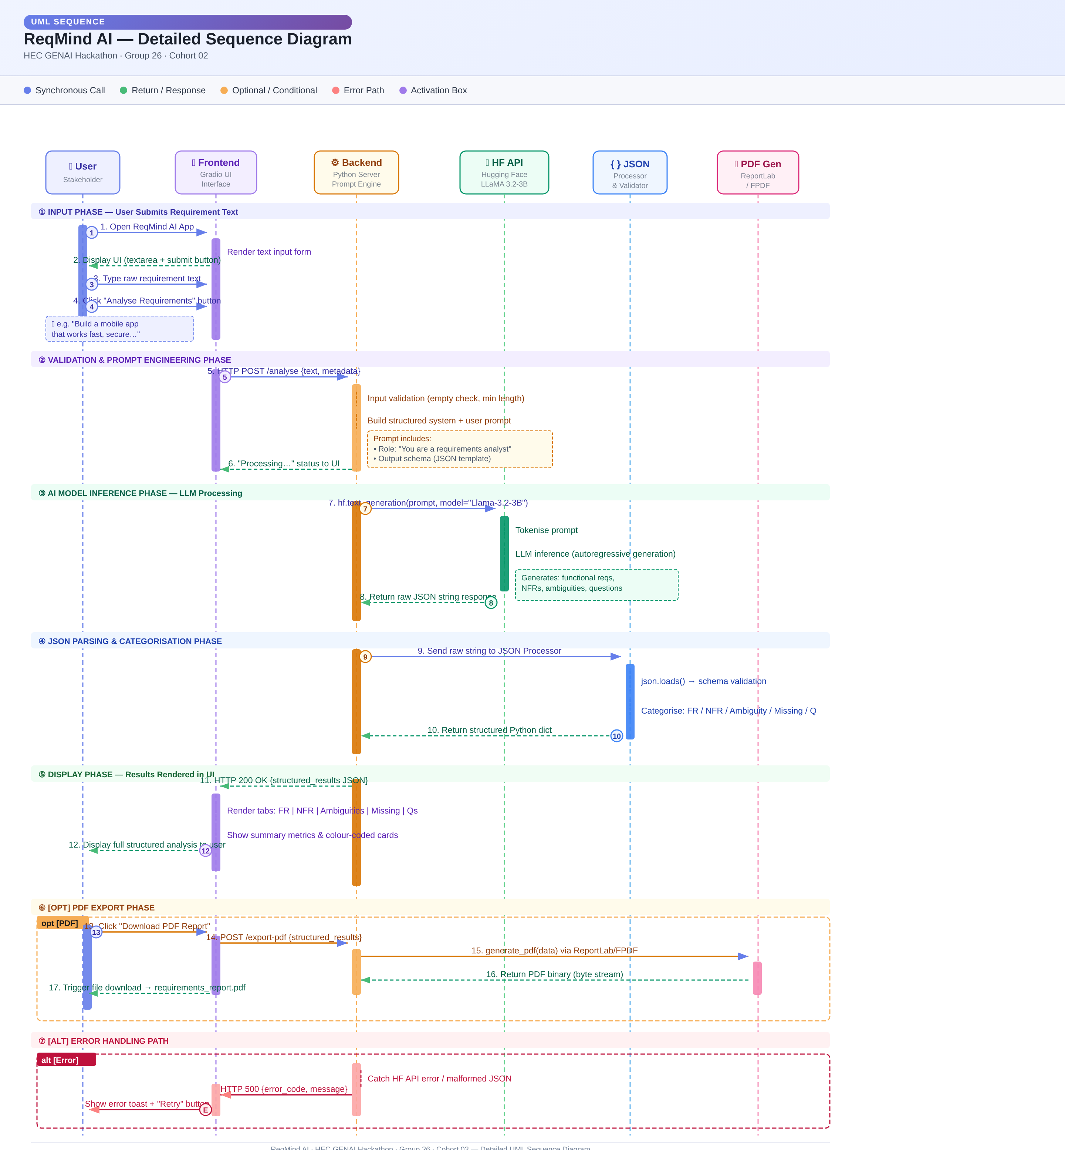
SYSTEM ARCHITECTURE
Sequence Flow: Eight-Step Processing Pipeline
1
User submits raw requirement text
2
Frontend sends request to backend
3
Backend formats structured prompt
4
Request sent to Hugging Face model
5
Model returns structured JSON
6
Backend processes & categorizes
7
Results displayed in UI
8
Optional PDF report generated

Slide 15
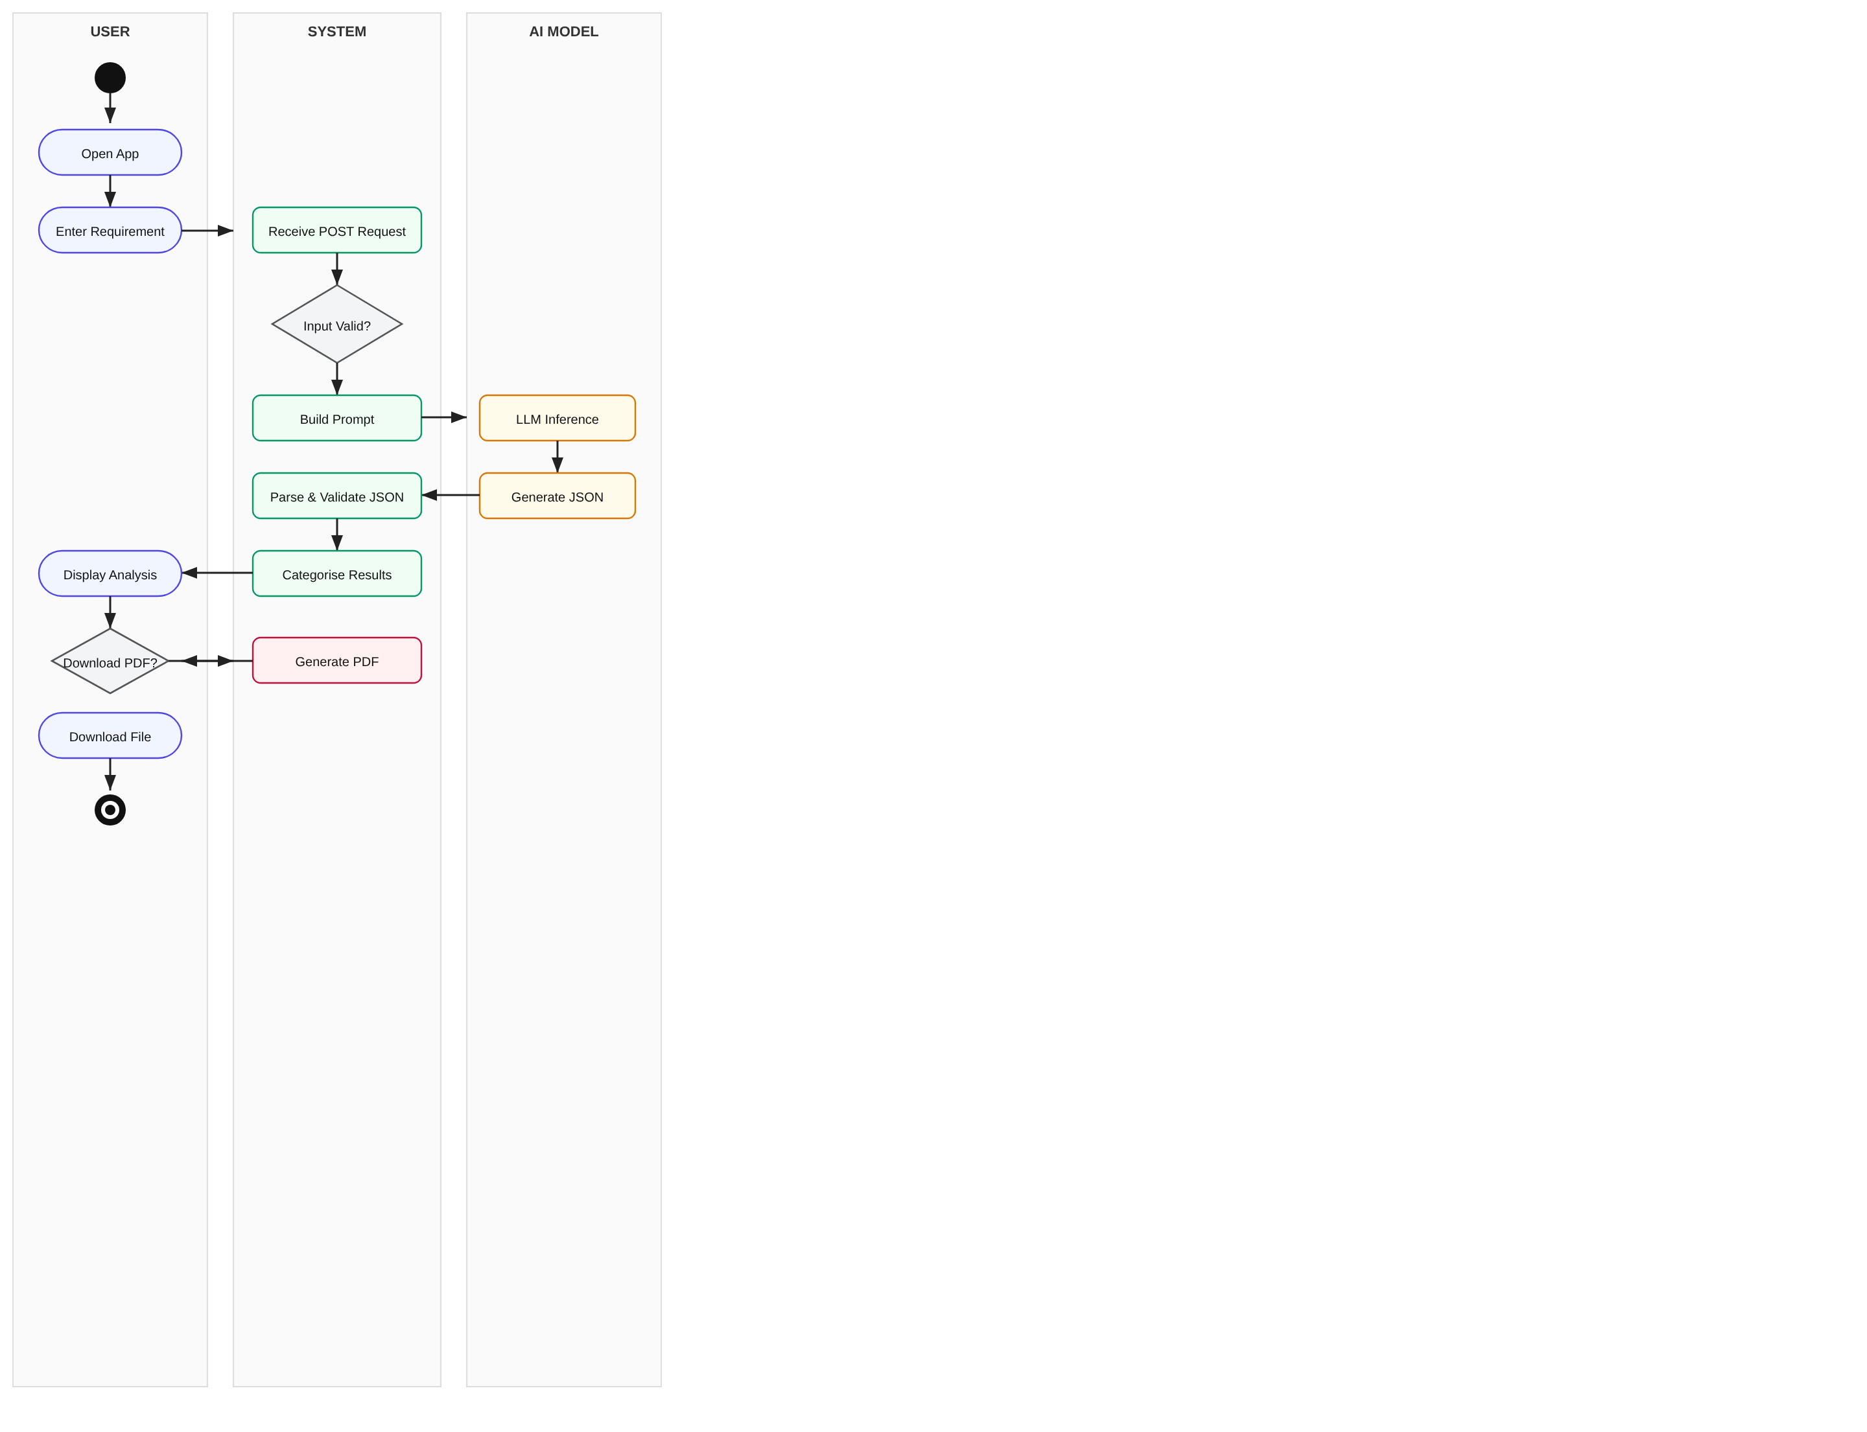
SYSTEM ARCHITECTURE
Activity Diagram:

Slide 16
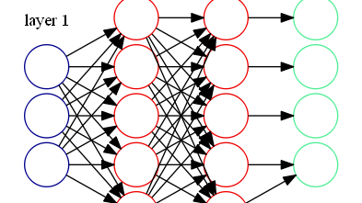
CHAPTER 09
Conclusion
The Future of Requirement Engineering

Slide 17
CONCLUSION
ReqMind AI's Contribution
Core Achievement
Key Impact Metrics
ReqMind AI addresses a fundamental challenge in software engineering: unclear and incomplete requirements that lead to project failures, cost overruns, and delays.
Time Reduction
80%
From 4-8 hours to <30 min
7
Core Capabilities
Comprehensive analysis features
AI-Powered Innovation
100%
Structured Output
By leveraging Generative AI , the system automates requirement structuring, ambiguity detection, and clarification generation—transforming manual processes into intelligent automation.
JSON + PDF generation
Scalable Architecture
Vision
The modular architecture and scalable design make ReqMind AI suitable for academic research, hackathon demonstrations, and industry-level production deployments.
"Transforming requirement engineering from a bottleneck into a competitive advantage through intelligent automation."

Slide 18
CHAPTER 10
Demo
Interactive version of ReqMind AI.

Slide 19
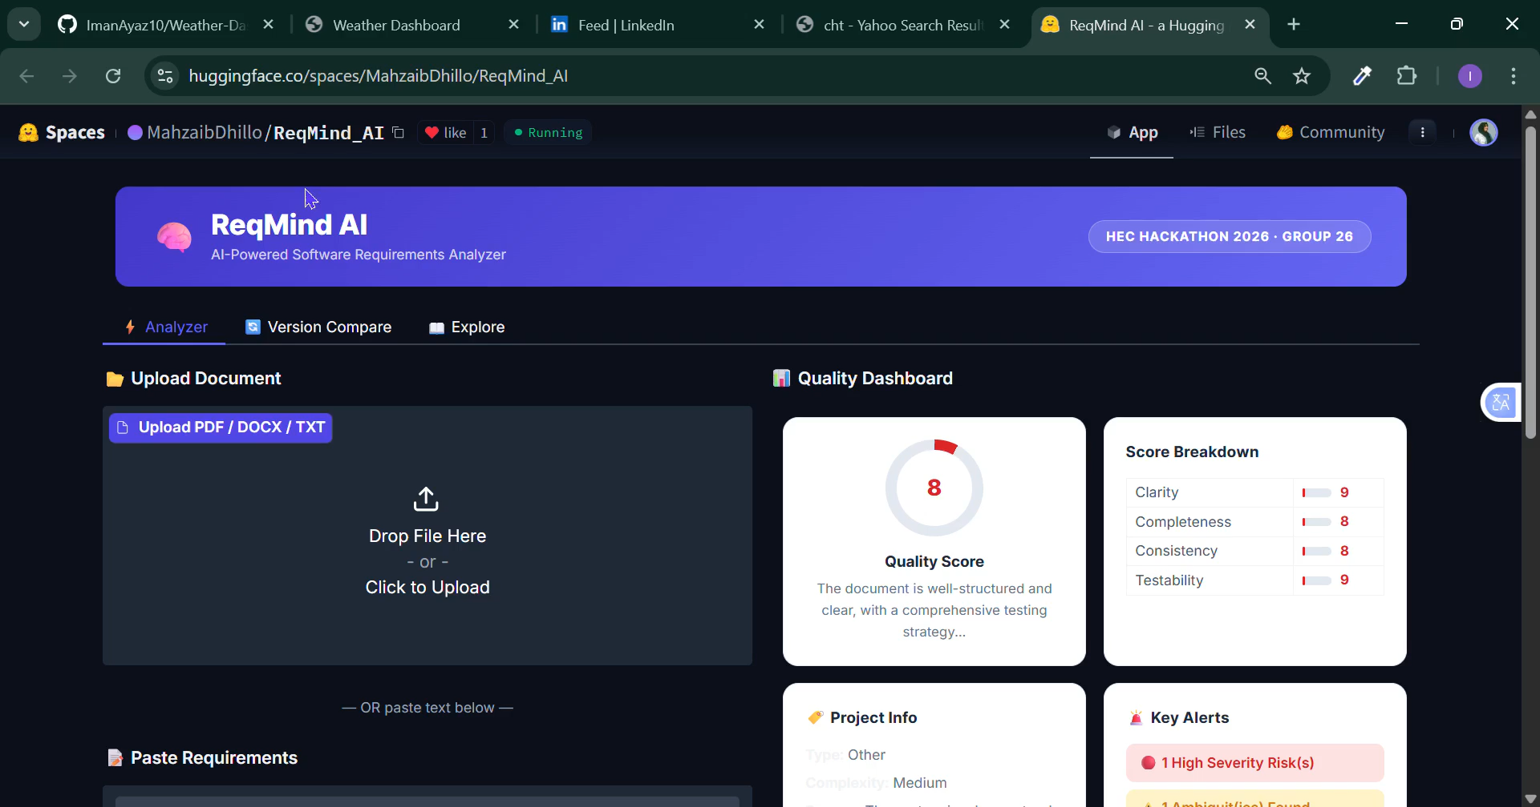

Slide 20
HEC GENAI HACKATHON
Thank You
Questions & Discussion
Group 26, Cohort 02
Asifa Siraj
Warisha Danin Bilal
Iman Ayaz
Zobia Hassan
Mahzaib Iqbal
Mansoor Ahmed
ReqMind AI - Intelligent Requirement Analysis System
February 2026

